Slide 1
OOSE Project - LifeLine Blood Donation App
Sanat Madkar - B050
Mann Merani-B060
Rahil Merchant-B061

Slide 2
Introduction
There is an expectation that the blood will always be there when it is really needed. Blood donor volunteers constitute the main supply source in an effective blood supply chain management. They feed blood stocks through their donation. In an emergency situation, if the stocks are insufficient, the only source of blood supply will be the people who come to the health centre and donate the blood on a voluntary basis. With rapid increase in the usage of social networks sites across the world, there is also a steady increase in blood donation requests as being noticed in the number of posts on these sites such as Facebook and Twitter, seeking blood donors. A smart phone application is developed to allow donors to look for hospitals near them to donate blood. Apart from this, the user can also choose to get their blood report generated; by paying online, getting their blood tested, and getting their report on the app.

Slide 3
Motivation
Despite all the advances in medicine and technology, an alternative medical way to substitute blood, blood components or blood-derived products have not been found yet. Blood can only be supplied by living donors. Blood transfusion has been responsible for saving millions of lives each year around the world. Yet the quantity and quality of bloodpool available for transfusion is still a major concern across the globe, especially in the developing countries. It is estimated that our country has a blood deficit of between 30% and 35% every year. In a land of 1.2 billion people it's ridiculous to say we can't meet the requirement.
Lifeline is a blood donation app which helps volunteer blood donors to find hospitals in their vicinity to donate blood. Aside from this, one can also get their blood report at the ease of their android smartphones, for which they can pay using the online payment portal, RazorPay.
With incentives and rewards for frequent donors, LifeLine makes blood donation worthwhile.

Slide 4
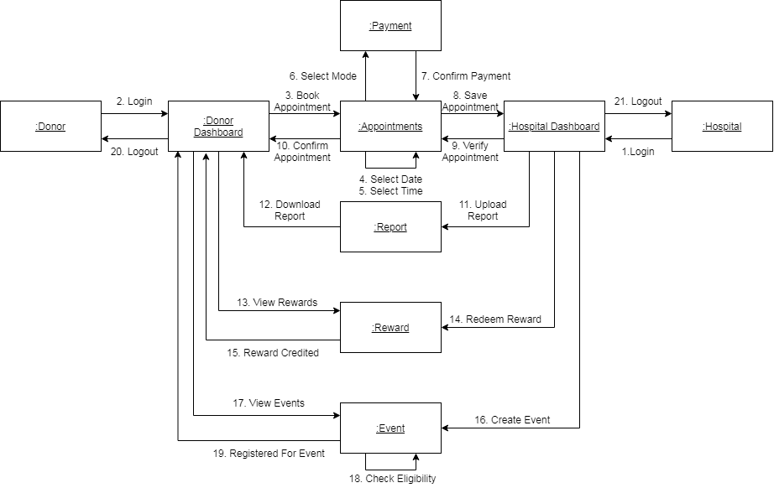
Flow of Application

Slide 5
Functional Requirements
User Interface-A good user interface acts as an incentive for the user to keep using our app and also help attract new users
Profile Login-Helps maintain authenticity of the user
User Details-This data is only accessible to the Hospital when the user donates blood. This is helpful in case of emergency.
Separate Portal for Donor and Hospital-Different portal for hospital and donors as different kind of functionalities are offered to both.
Create Event-Allows Hospital to Give Information about Donation Drives
Events-Gives user information about donation drives
Rewards System-Gives user an incentive to donate blood
Leaderboard-Introduces a competitive spirit to donate blood
Book Appointment-Saves time of the user by giving them a time slot to donate or test their blood
Report Generation-Hospital can send users their reports easily with the help of this app in pdf format.
Payment-Users can pay for their blood reports through our app

Slide 6
Non Functional Requirements
Security of personal information of the user
Friendly and easy to use User Interface
Performance-It should be accessible 24/7 for 365 days.
Accessibility
Efficiency
Profile Setup Stored in Firestore database
Quality assurance
Privacy
Effectiveness
Portability

Slide 7
System Requirements
Internet Access
Android 5.0 and above
Location Access
Storage Access
25MB free in internal memory to install application

Slide 8
Hardware/Software Used
Hardware Required:
Android Phone with Internet Connectivity
GPS Service
Software Used:
Android Studio
Firebase Firestore - The database for the application
Firebase Storage - Cloud storage used to store event images and PDFs of reports
Firebase Authentication - Used to authenticate users
Glide library - Used to display images stored on the cloud server
Horizontal calendar library
Google API - Used for Login via Google account and data analytics.
Google Maps - Used to display locations of hospitals and events.
RazorPay API - Used for processing payments made by the donor for the report.

Slide 9
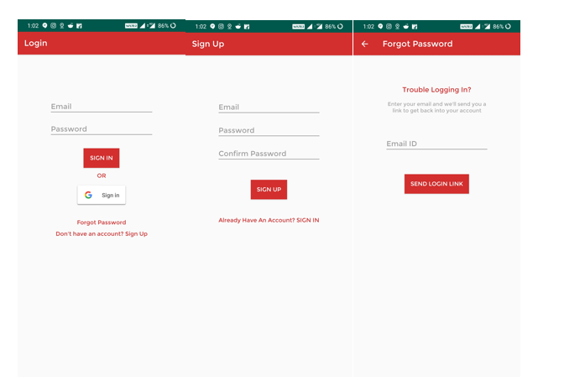
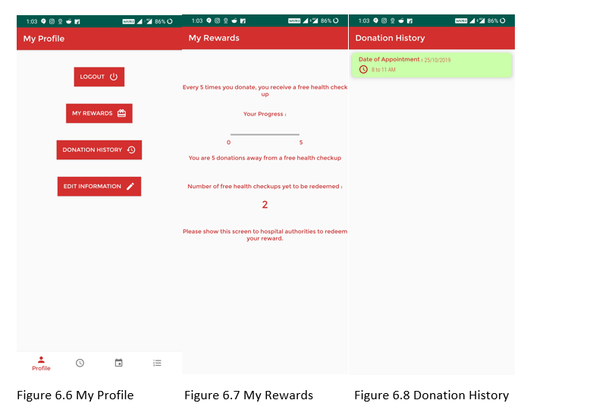
Screenshots

Slide 10
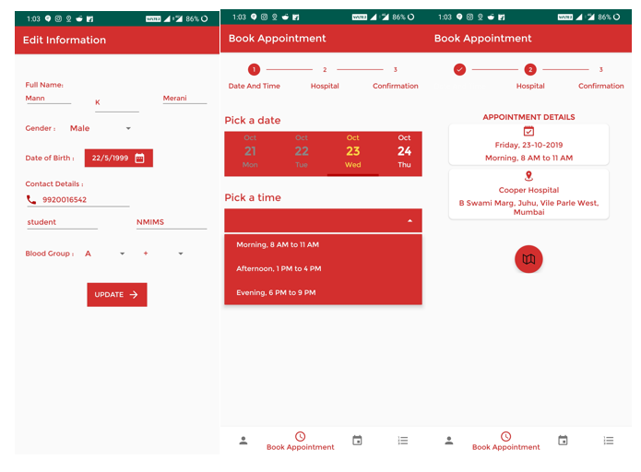
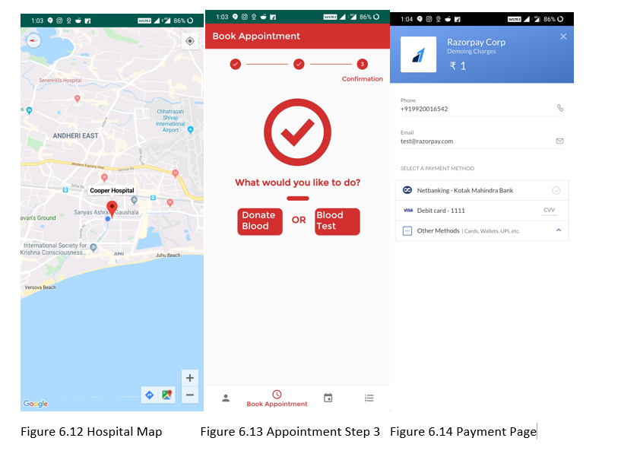
Screenshots Contd.

Slide 11
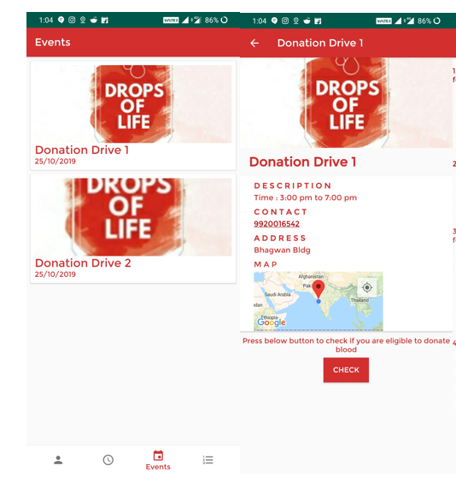
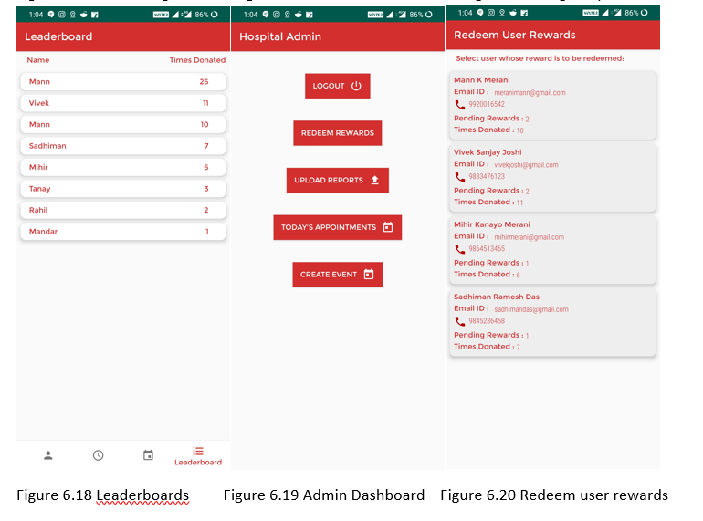
Screenshots Contd.

Slide 12
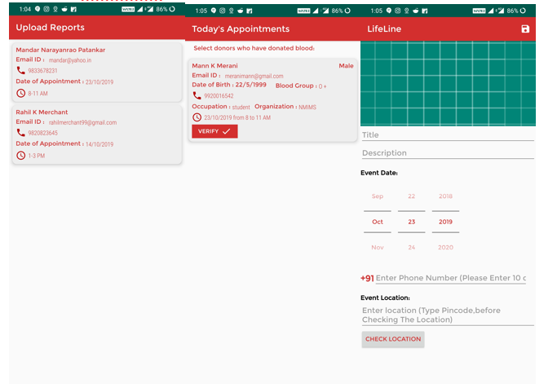
Screenshots Contd.

Slide 13
Advantage of System
Very Secure where all actions are committed at the end of a function call
Secure login where password is hidden
Same application for regular customers, admin users
24X7 Service
Rewards and incentives for frequent donors.
Free-of-cost
User friendly interface
Paperless Reports
Saves waiting time by avoiding queues

Slide 14
Disadvantage of Current System
No type of reward system
No geographic availability in India
No Google Sign In
No major security systems in place during login
No type of leaderboard system
No digital interface to offer communication between hospital and donor
Limited direct interaction between hospital and donor
No preparation or relaying of information on large amounts of donation on short notice
Hospital phone lines may be busy; need another way of interaction

Slide 15
Future Scope
LifeLine can be further developed and expanded to various hospitals in the city, and also other cities.
For this the databases will have to be upgraded and they should be able to handle the load of the thousands of users that will be accessing the application.
We’d also like to add additional features like notifications and reminders, QR codes and reviews to further enhance user experience.
Currently, LifeLine is an android application, and we’d like to develop an online website as well as an iOS application.

Slide 16
Conclusion

